Slide 1
Artificial Intelligence
Introduction : A Course Outline

Slide 2
Agenda
Introduction to the Subject
Introduction to the Course Objectives and Learning Outcomes
Pre- Requisite for the Course
Importance of the Subject and Examples where it will be useful
Methodology and Assessment Criteria for the Subject

Slide 3
What is Intelligent Behaviour ?
Learn from experience
Respond flexibly in situation that are
New or not anticipated
Ambiguous (not clearly defined)
Specified by contradictory information
Apply ‘learnt’ or ‘programmed’ knowledge to solve problems
Use reasoning in solving problems
Understand and infer facts and rules
Recognize the relative importance of different elements in a situation

Slide 4
Elements of Intelligent Performance
Perceive,
Reason and Infer,
Solve problems,
learn and adapt,
apply common sense,
apply analogy,
recall,
apply intuition,
reach emotional states,
achieve self-awareness

Slide 5
What is Artificial Intelligence ?
“Artificial Intelligence (AI) is a branch of computer science devoted to creating computer software and hardware to attempt to mimic human intelligence or human intelligent behaviour “
Or
“AI research is an attempt to discover and describe aspects of human intelligence that can be simulated by machines”

Slide 6
Comparing Human Vs Computers
Computers Are Good At
Humans Are Good At
Recognizing various things, either seen before or not
Recognizing the relationship patterns between things
Thinking – common sense reasoning
Combining all types of sensory inputs
Acting appropriately in novel situations
Learning new things and changing behavior patterns
Making decisions even when given incomplete information
Working with noisy, incomplete or ambiguous information
Processing large amount of data
Storing (permanently) and retrieve large amount of data
Working at extremely fast speeds
Doing extensive arithmetic calculation with great accuracy
Working for long periods without fatigue

Slide 7
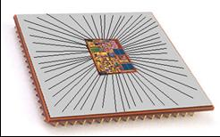
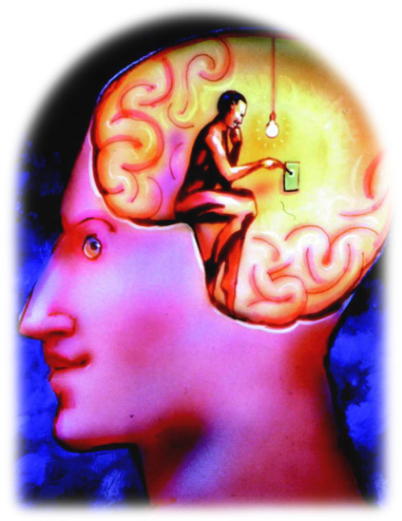
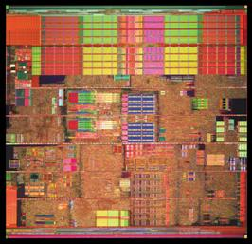
Brain vs. Computer
In AI, we compare the brain (or the mind) and the computer
Our hope: the brain is a form of computer
Our goal: we can create computer intelligence through programming just as people become intelligent by learning
But we see that the computer is not like the brain
The computer performs tasks without understanding what its doing
Does the brain understand what its doing when it solves problems?

Slide 8
What is Artificial Intelligence? (again)
Systems that think like humans
Cognitive Modeling Approach
“The automation of activities that we associate with human thinking...”
Bellman 1978
Systems that act like humans
Turing Test Approach
“The art of creating machines that perform functions that require intelligence when performed by people”
Kurzweil 1990
Systems that think rationally
“Laws of Thought” approach
“The study of mental faculties through the use of computational models”
Charniak and McDermott
Systems that act rationally
Rational Agent Approach
“The branch of Computer Science that is concerned with the automation of intelligent behavior”
Lugar and Stubblefield
Notes:
Basic Framework...
Getting computers to do the right thing based on their circumstances and what they know!

Slide 9



System Acting Humanly
The Turing Test (1950)
Can machines think?
Can machines behave intelligently?
Operational test for intelligent behavior
The Imitation Game
?
Human
Human
Interrogator
AI System

Slide 10
Cognitive Tasks (Turing Tests )
Natural language processing
- for communication with human
Knowledge representation
-to store information effectively & efficiently
Automated reasoning
-to retrieve & answer questions using the stored information
Machine learning
-to adapt to new circumstances
Computer vision
to perceive objects (seeing)
Robotics
to move objects (acting)

Slide 11
Areas of AI and Some Dependencies
Knowledge Representation
Search
Logic
Machine Learning
Planning
Expert Systems
NLP
Vision
Robotics
Notes:
growing commercial technologies
Expert System
Computerized advisory and/or decision making systems that attempt to imitate the reasoning process and knowledge of experts in solving domain-specific problems
Natural Language Processing
Natural language technology attempts to give computer users the ability to communicate with computer in natural language. Also deals with understanding textual language for various applications
Robotics and Sensory Systems
Combining robots having mechanical motions with sensory system to produce machines of varying intelligence and abilities. Here a robot senses its environment and modifies its behavior on the basis of the information gained.
Computer vision and scene recognition
To understand digitized visual information received from a sensor and then making a decision – interpreting a visual scene
Logic and Artificial Intelligence. Artificial Intelligence (referred to hereafter by its nickname, “AI”) is the subfield of Computer Science devoted to developing programs that enable computers to display behavior that can (broadly) be characterized as intelligent
Knowledge representation and reasoning (KR, KR², KR&R) is the field of artificial intelligence (AI) dedicated to representing information about the world in a form that a computer system can utilize to solve complex tasks such as diagnosing a medical condition or having a dialog in a natural language.
A Heuristic is a technique to solve a problem faster than classic methods, or to find an approximate solution when classic methods cannot
The planning in Artificial Intelligence is about the decision making tasks performed by the robots or computer programs to achieve a specific goal

Slide 12



Examples of Artificial Intelligence
Video Games
Mobile Games
Personal Assistants

Slide 13
Pre-Requisite for the Course
Various Level of Maths
Understanding of Computing Systems

Slide 14
Learning Outcomes with the Subject
Knowledge and understanding You should have a knowledge and understanding of the basic concepts of Artificial Intelligence including Search, Game Playing, KBS (including Uncertainty), Planning and Machine Learning.
Intellectual skills You should be able to use this knowledge and understanding of appropriate principles and guidelines to synthesise solutions to tasks in AI and to critically evaluate alternatives.
Practical skills You should be able to use a well known declarative language to construct simple AI systems.
Transferable Skills You should be able to solve problems and evaluate outcomes and alternatives

Slide 15
Methodology And Assessment Criterias
Class Assignment(s)
Each chapter being covered will have one assignment. The Case Studies will be given in line to the Changing with Speed across IT Projects in Kirirom
Internal Exam(s)
There will be 2 exams
Model Exam
There will be one Model Exam.
Semester Exam
There will be 1 Semester Exam

Slide 16
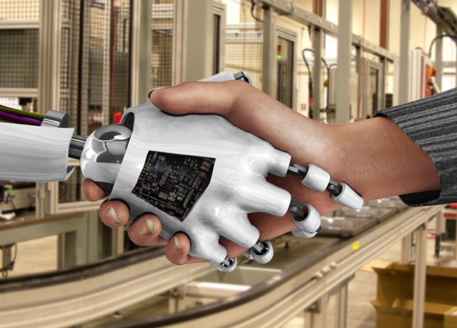
Thank You !
“Our intelligence is what makes us human, and AI is an extension of that quality.”
– Yann LeCun

